Slide 1
A Turbulence Model for Gas-Particle Flows with Favre-Averaging : III. Closures Dr. Thomas J. O’Brien NETL-emeritus
1847 Joliet Way
Boulder, CO 80305
TOBBoCo@gmail.com
304-816-6332
2014 Multiphase Flow Science Conference
National Energy Technology Laboratory (NETL)
Lakeview Golf Resort &Spa, Morgantown, WV
Aug. 5&7, 2014

Slide 2
Outline
What is multiphase turbulence?
Favre-like (phasic) average
Summary of averaged equations: continuity, momentum and granular temperature
Equations
Closures
Expansion of closure relations
Turbulent kinetic energy equations
Derivation
Closures
Future formal work
Boundary conditions
Thermal temperatures
Chemistry

Slide 3
Steady-State Calculations
Transient calculations are very costly and time consuming, although they are possible.
It is difficult to base scoping studies (design, process simulation) on transient calculations.
Coupling of CFD to process simulations requires a “lower order model,” faithfully reduced from the full transient model.
Multiphase flows are inherently transient … the effects of which must be captured faithfully by a turbulence model.

Slide 4
General Comments
Most work published is based on modifications of gas phase turbulence theory… this probably won’t work for dense flows. Energy is in the granular fluctuations.
Current approach … turbulence is a property of a fluid, so a granular continuum theory has to be the starting point.
Utilize the concept of Favre-like (phasic) averaging, to reduce the closure “burden.”

Slide 5
Multiphase Turbulence
Single average approach
Average microscopic equations to obtain “two-fluid” equations describing interpenetrating continuum, characterized by:
all functions of space and time.
Examine “fluctuations” of the microscopic variables about these two-fluid variables.
Double average approach
Average again to obtain mean behavior
Examine “fluctuations” about these, e.g.,
Notes:
Previous double average work:
Elghobashi, S.E., and T.W. Abou-Arab, “A two equation turbulence model for two- phase flows,” Phys. Fluids 26, 931-938, 1983.
Bolio, E., and J. Sinclair, “Gas turbulence modulation in the pneumatic conveying of massive particles in vertical tubes,” Int. J. Multiphase Flow 21, 985-1001, 1995.
Dasgupta, S., R. Jackson and S. Sundaresan, “Turbulent gas-particle flow in vertical risers,” AIChE J. 40, 215-228, 1994.
Hrenya, C., and J. Sinclair, “Effects of particle-phase turbulence in gas-solid flows,” AIChE J. 43, 853-869, 1997.
Simonin, O., “Statistical and continuum modelling of turbulent reactive particulate flows. Part I: Theoretical derivation of dispersed phase Eulerian modelling from probability density function kinetic equation,” Lecture series - von Karman Institute for Fluid Dynamics 6, D1-D42, 2000.
Previous double average work, including some Favre-like averaging:
Besnard, D.C., and F.H. Harlow, “Turbulence in multiphase flow,” Int. J. Multiphase Flow 14, 679-699, 1988.
(Dasgupta, S., R. Jackson and S. Sundaresan, “Turbulent gas-particle flow in vertical risers,” AIChE J. 40, 215-228, 1994.)
Krepper, E., D. Lucas and H.-M. Prasser, “On the modelling of bubbly flow in vertical pipes,” Nucl. Eng. Des. 235, 597–611, 2005.
Krepper, E., M. Beyer, T. Frank, D. Lucas and H.-M. Prasser, “CFD modelling of polydispersed bubbly two-phase flow around an obstacle,” Nucl. Eng. Des. 239, 2372–2381, 2009.
Lahey Jr., R.T., and D.A. Drew, “The analysis of two-phase flow and heat transfer using a multidimensional, four-field, two-fluid model,” Nucl. Eng. Des. 204, 29–44, 2001.
Lahey Jr., R.T., “The simulation of multidimensional multiphase flows,” Nucl. Eng. Des. 235, 1043-1060, 2005.
Previous work, miscellaneous
Boelle, A., G. Balzer and O. Simonin, “Second-order prediction of the particle-phase stress tensor of inelastic spheres in simple shear dense suspensions,”ASME-Publications-FED-228, 9-18, 1995.
Gobin, A., H. Neau, O. Simonin, J.R. Llinas, V. Reiling and J.-L. Selo, “Fluid dynamic numerical simulation of a gas phase polymerization reactor,” Int. J. for Numerical Methods in Fluids 43, 1199-1220, 2003.
Gevrin, F., O. Masbernat and O. Simonin, “Granular pressure and particle velocity fluctuations prediction in liquid fluidized beds,” Chem. Eng. Sci. 63, 2450-2464, 2008.

Slide 6
Single Average Approach
Indicator function of fluid/solids phase:
Fluid/solids phase fraction:
Conditional average, based on the gas/solids phase:
,e.g.,
Turbulent fluctuations:
, e.g.,
Notes:
Previous single average work:
Ahmadi, G., and D. Ma, “A thermodynamic formulation for dispersed multiphase turbulent flows – I Basic theory,” Int. J. Multiphase Flow, 16, 323-340, 1990.
Lhuillier, D., “Macroscopic modelling of multi-phase mixtures,” in U. Schaflinger, ed., Flow of Particles in Suspensions, Springer-Verlag, 39-91, 1996.
Liljegren, L.M., “Fluctuating kinetic energy budget during homogeneous flow of a fluid solid mixture,” Phys. Fluids 8, 84-90, 1996.
Liljegren, L.M., “The dissipation rate of fluctuating kinetic energy in a fluid-solid flow,” Phys. Fluids 6, 3795-3797, 1994.
Kashiwa, B.A., and W.B. VanderHeyden, “Toward a general theory for multiphase turbulence Part I: Development and gauging of the model equations,” LA-13773-MS, Dec. 2000.

Slide 7
Favre & Favre-like Averaging
Favre average: compressible gas
Favre, A., “Équations des gaz turbulents compressibles
I.- Formes générales,”
Journal de Mécanique 4, 361-390, 1965.
Favre, A., “Formulation of the statistical equations
of turbulent flows with variable density,”
in Studies in Turbulence, T.B. Gatski, S. Sarkar and C.O. Speziale eds.,
Springer-Verlag, 324-341, 1992.
Favre-like or phase average: two-fluid model
Notes:
Favre, A., “Équations des gaz turbulents compressibles I. - Formes générales,” Journal de Mécanique 4, 361-390, 1965.
Favre, A., “Formulation of the statistical equations of turbulent flows with variable density,” in Studies in Turbulence, T.B. Gatski, S. Sarkar and C.O. Speziale eds., Springer-Verlag, 324-341, 1992.

Slide 8
Physical Meaning of Phase-average Velocity
“The Favre velocity is a mean variable … that includes the velocity fluctuation correlated with density fluctuation. (The Favre velocity fluctuation is) … only the part uncorrelated with density.”
Besnard, D.C., and F.H. Harlow, “Turbulence in multiphase flow,” Int. J. Multiphase Flow 14, 679-699, 1988.
Notes:
Besnard, D.C., and F.H. Harlow, “Turbulence in multiphase flow,” Int. J. Multiphase Flow 14, 679-699, 1988.

Slide 9
Notation
Dependent two-fluid variables:
Reynolds mean:
Favre mean:

Slide 10
Notation
Dependent variables:
Reynolds decomposition
Favre decomposition

Slide 11
Continuity Equations
Gas phase
Solids phase

Slide 12
Gas Phase Momentum Equations

Slide 13
Solids Phase Momentum Equations

Slide 14
Granular Temperature Equation
Turbulent Granular Temperature Flux vector

Slide 15
Correlations
Relating Reynolds mean to phase-averaged mean:
Continuity equations: – none, but …
Momentum equations:

Slide 16
Correlations (cont.)
Granular temperature equation:

Slide 17
Correlations
Relating Reynolds mean to phase-averaged mean:
Momentum equations:
Granular temperature equation:

Slide 18
Gas & Solids Phase Momentum Equations

Slide 19
Mean Phase Interaction Coefficient

Slide 20
Representaions for
A fitting parameter, independent of space (and time):
Same function , but in terms of Reynolds-averaged variables:
Same function ,but in terms of Favre-averaged velocity variables:
Notes:
Agrawal, K., P.N. Loezos, M. Syamlal and S. Sundaresan, “The meso-scale structures in rapid gas-solid flows,” J. Fluid Mech. 445, 151-185, 2001

Slide 22
Functional Taylor Series Expansion
Hrenya, C and J. Sinclair, “Effects of particle-phase
turbulent in gas-solid flows,” AIChE J., 43, 853-869, 1997.
Notes:
Hrenya, C and J. Sinclair, “Effects of particle-phase turbulent in gas-solid flows,” AIChE J., 43, 853-869, 1997.

Slide 23
Functional Taylor Series Expansion

Slide 24
Recommended Form for

Slide 25
Wen & Yu
Notes:
Agrawal, K., P.N. Loezos, M. Syamlal and S. Sundaresan, “The meso-scale structures in rapid gas-solid flows,” J. Fluid Mech. 445, 151-185, 2001

Slide 26
Wen & Yu
Notes:
Agrawal, K., P.N. Loezos, M. Syamlal and S. Sundaresan, “The meso-scale structures in rapid gas-solid flows,” J. Fluid Mech. 445, 151-185, 2001

Slide 27
Gas & Solids Phase Momentum Equations

Slide 28
Volume Fraction-Gas Pressure Correlations
Only the correlations are required.

Slide 29
Gas & Solids Phase Momentum Equations

Slide 30
Mean molecular viscosity stress
No new correlation is required:

Slide 31
Gas & Solids Phase Momentum Equations

Slide 32
KTGF Granular Stress

Slide 33
KTGF Granular Stress (cont.)

Slide 34
Kinetic Theory of Granular Flow Granular Temperature Equation
Turbulent Granular Temperature Flux vector
Dilatation & Solenoidal Dissipation

Slide 35
Specific Gas Phase Turbulence Kinetic Energy
Total kinetic energy of gas flow is nicely partitioned:
The first term is the energy density of the gas flow due to the
combined mean motion and turbulent motion correlated with the void fraction.
The second term is the gas energy density due to
the residual turblent motion, i.e., that not correlated with voidage fluctuations.
Besnard, D.C., and F.H. Harlow, 1988.

Slide 36
Specific Solids Phase Turbulence Kinetic Energy
Total kinetic energy of solids flow is nicely partitioned:
The first term is the energy density of the granular flow due to the
combined mean motion and turbulent motion correlated with the solids fraction.
The second term is the solids energy density due to
the residual turblent motion, i.e., that not correlated with solids fluctuations.
Besnard, D.C., and F.H. Harlow, 1988.

Slide 37
Gas Phase Turbulence Kinetic Energy

Slide 38
Solids Phase Turbulence Kinetic Energy

Slide 39
Kinetic Energy Density of the Flow
Kinetic energy density of the gas phase
Kinetic energy density of the solids phase
Total kinetic energy density of the flow

Slide 40
Average Kinetic Energy Density of the Gas Phase
gas phase specific turbulence kinetic energy
… measures the residual turbulent motion.
Besnard et al, 1992
… the energy density due to the combined mean
and density-correlated turbulent motion,

Slide 41
Average Kinetic Energy Density
solids phase specific
turbulence kinetic energy

Slide 42
Correlations

Slide 43
Closures velocity & volume fraction

Slide 44
Closures velocity relations

Slide 45
To Do List
Extract dissipation, ε_{g/s}
Closures for k_{g/s} & ε_{g/s}
Look at energy cascade
Equation for the full stress tensor, τ
Compare in detail with Reynolds formalism
Formulate drag terms for a chosen form
Include thermal temperatures
Chemistry (contacting)– hopefully temperature fluctuations will be small
Develop closure relationships
… related to specific experimental data
(A NEVER ENDING TASK)

Slide 46
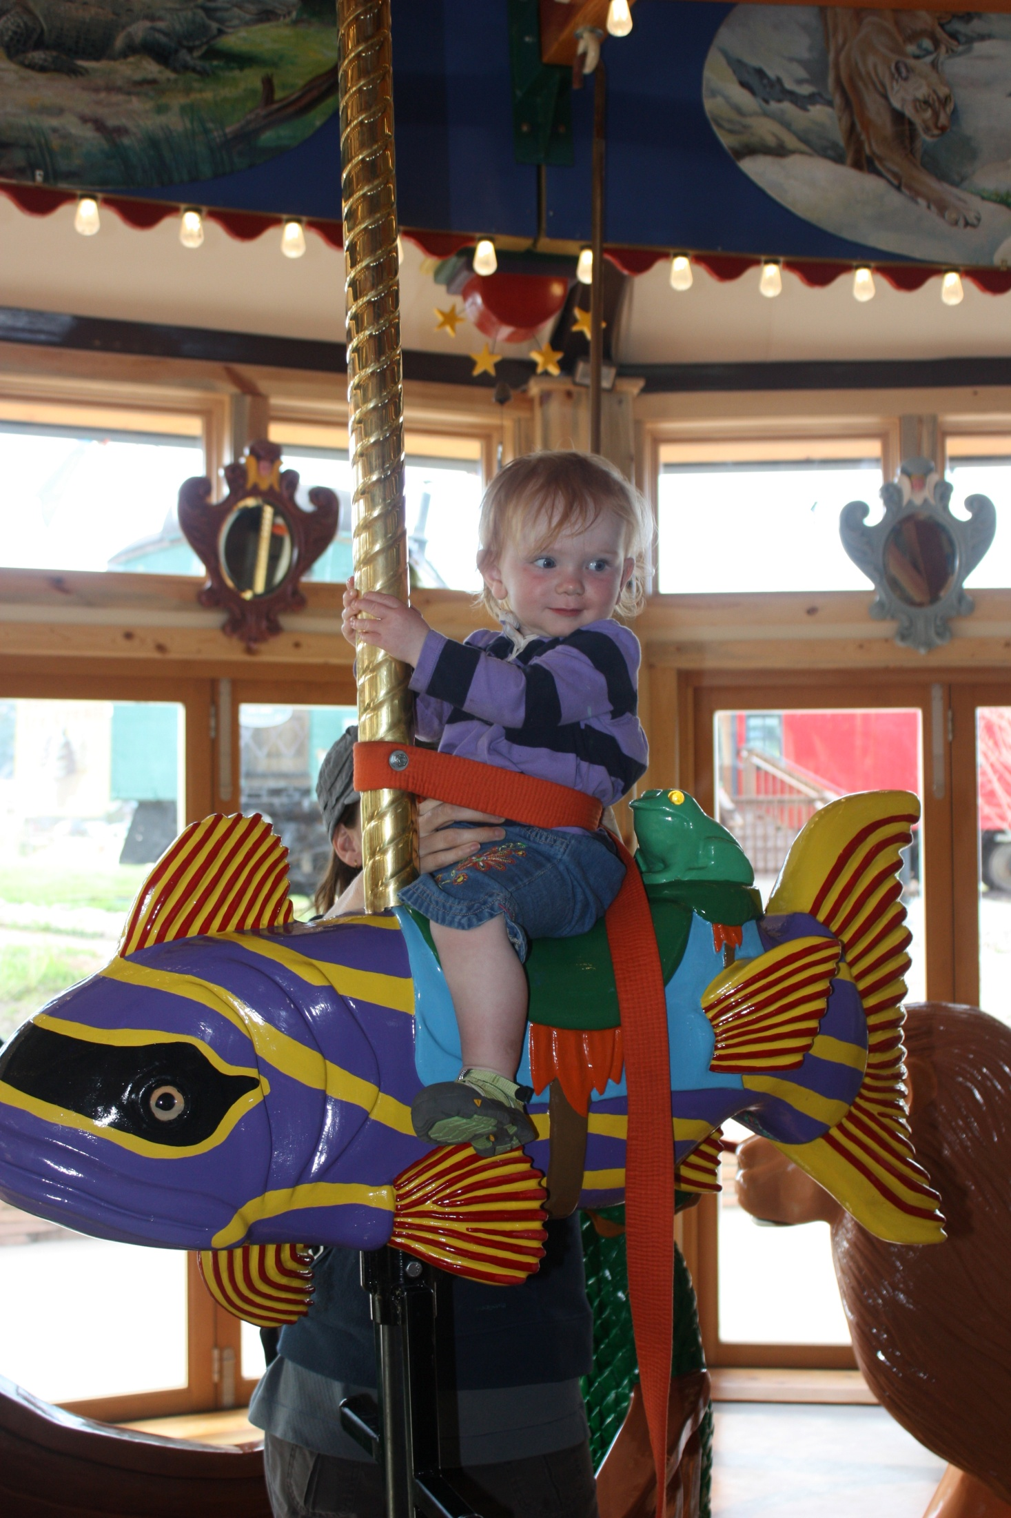
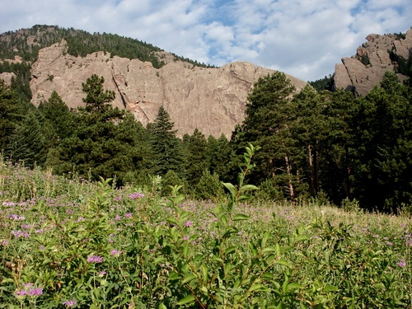
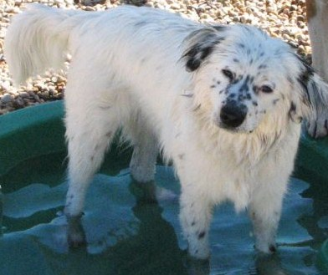
Thank you Questions?
TOBBoCo@gmail.com, 304-816-6332, 1847 Joliet Way, Boulder, CO 80305
… or Munich, Germany

